Slide 1
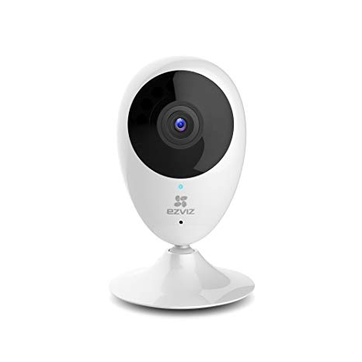
EZVIZ Security Camera Pen Test
Final Results: 5/2/19
The Watchers: Thomas Layne, Jose Hernandez, Christian Escobar, Khalid Al Salehi, Mohammed Al Harthi, Sean Rooney

Slide 2
Overview
Project Goals
Scope
Findings and Outcomes
Hikvision Software
Open Port 554
Weak Admin Credentials
Cannot Change Credentials
Aireplay-ng Attack
Enforced Android App Security
Closing Comments

Slide 3
Project Goals
Build experience practicing skills learned in coursework
Pentest camera with a variety of methodologies
Intercept video/remotely control device
Test the security of its mobile applications
Analyze packets passively and see what can be observed
Attempt to leverage the HTTP requests it transmits
Use parent companies software to achieve more access to the camera
Attempt to connect to the camera through a TCP connection

Slide 4

Scope of Attack Vectors
In Scope
Android app
iOS app - fell out of scope
Web app on the device
Network attacks on an isolated network
Micro SD card slot - fell out of scope
Out of Scope
Live EZVIZ/Hikvision servers
Network traffic outside of our LAN
Added to Scope
Hikvision iVMS camera management software

Slide 5
Findings and Outcomes

Slide 6
Hikvision Software
Software not meant for EZVIZ consumer devices
We can edit, modify and change administrative settings
Does not allow for password change or create other accounts for the camera
Good and Bad
We can change the ports, signals, resolution, and connect things to the camera. With the default password we can take ownership of the cam.

Slide 7
Hikvision Software Cont.
Hikvision also develops a whole suite of other software for their technicians , developers, and admins of their cameras/devices.
We could leverage those tools to gain more access or reverse engineer the devices to find 0-day exploits.
As they recycle a lot of their components across their camera lines, the is a high probability the same exploits will work across several device models.

Slide 8
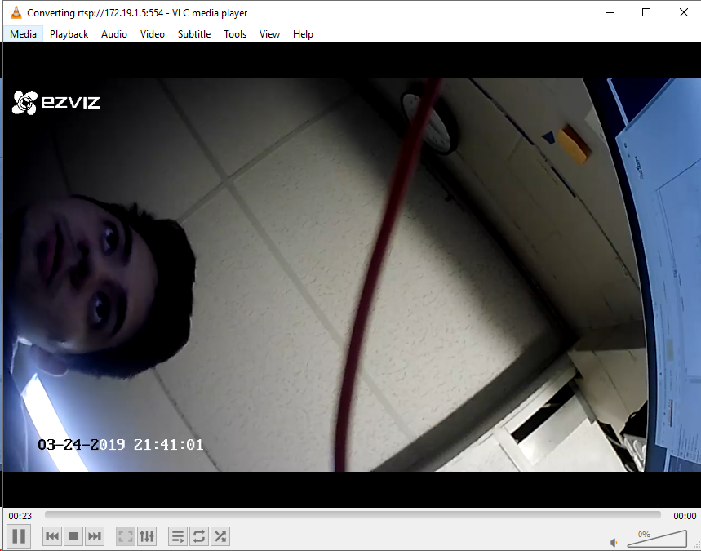
Port 554
The camera blindy sends data to that port, if you can validate you have the default credentials the camera does not care whether you are a legitimate application or a third party
VLC or other applications can get the data and modify how the stream is presented.
Record data using third part applications

Slide 9

Weak Credentials
Brute Force of wireless feed over port 554 wouldn't be possible without this.
6 all caps letters - Brute force attack with billions of guesses per second can crack it in 0.0024 seconds
Unlimited amount of failed attempts.

Slide 10
Cannot Change Credentials
Port 554 credentials can’t be changed from default
Application has the option to change the encryption password but doesn't affect port 554
Leaves camera vulnerable to Brute force attack

Slide 11
Aireplay-ng Attack
Tools used to implement Aireplay-ng
Kali vm
Kismet
Used to obtain the MAC address and channel for the access point (router) and the device
Wireless adapter
Steps taken
Lock onto the channel for the access point using “airmon-ng start wlan0mon 11”
Disrupt the camera’s authentication with:
“aireplay-ng -0 0 -a 9c:3d:cf:55:6f:64 -c 48:98:ca:f5:03:20 wlan0mon”
The flags and what they mean
-0 sets the attack to option 0. This sends authentication packets to the device while pretending to be the access point. The 0 argument just tells it to send them continuously.
-a This is the MAC or BSSID of the access point.
-c This is the MAC or BSSID of the device.

Slide 12
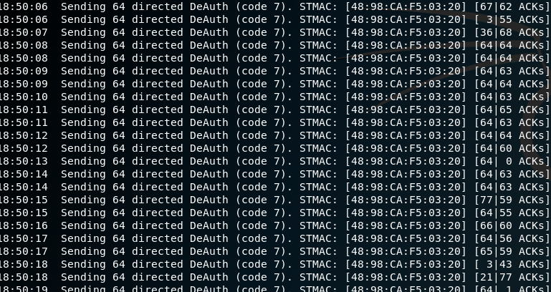

Slide 13

Android App Security
App cannot be installed on Android emulators
Makes malicious tinkering much more difficult
Network traffic is properly encrypted
Tcpdump revealed that packets used for sensitive data communications were encrypted
Internal logging of app activity is properly secured
Passwords are hashed
When text fields are changed (i.e camera name or encryption password), there is no identifiable clear text for these changes

Slide 14
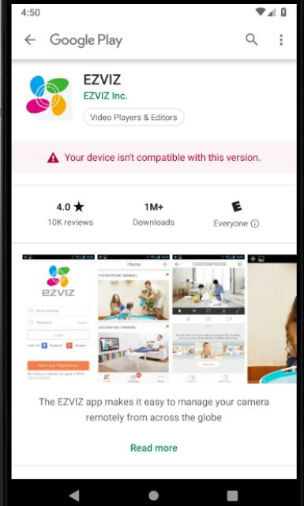
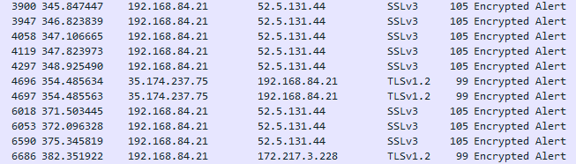
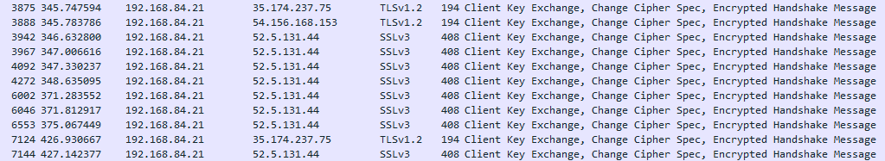

Slide 15
Closing Comments
EZVIZ got many things right in securing their device and its connected applications. However, it’s almost humorous they overlooked things as simple as proper administrative credentials protocols
Future work potential
More pentesting of the camera with iVMS. It was discovered late in the project’s progression and there could still be untapped potential
Shift focus to other IOT security cameras. Different models from EZVIZ or different brands all together may yield similar or different results

